Slide 1
Safety Network

Slide 2
Safety Network
Challenge selected:
From Curious Minds Come Helping Hands
The problem we’re facing:
We need a quick answer when a natural disaster or an emergency of any type just happened

Slide 3
Safety Network
Our proposal:
Development of an application
The hazardous area will be built in real time, as the users sets and confirm the disaster, and if they’re ok or not.

Slide 4
Safety Network: threats
Some of the disasters that a user can warn about are:
Floods
Wild Fire
Earthquakes
Zombie outbreak
Tornados
Alien invasion
Nuclear disaster

Slide 5


Safety Network: Build by users
DANGER
OK
OK
Hazard area

Slide 6
Safety Network: Build by users
Hazard area
Hazard area

Slide 7
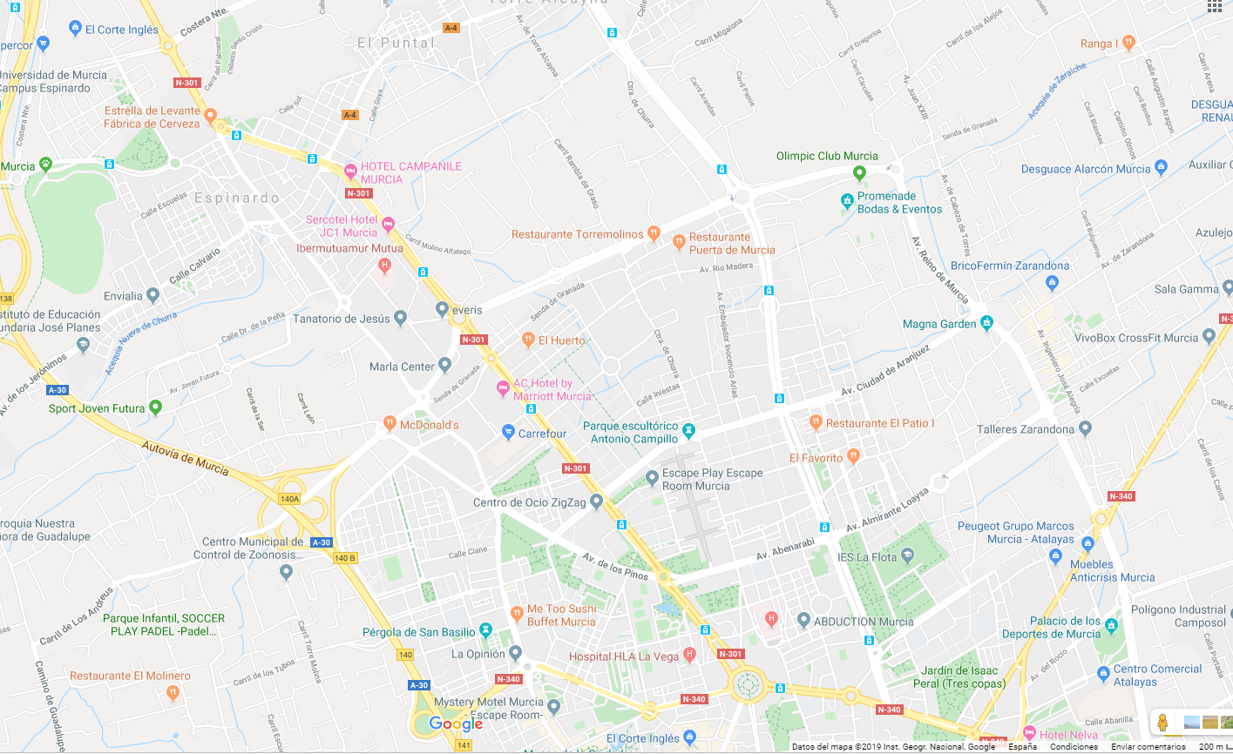
Safety Network: Example of spreading

Slide 8

Safety Network: Build by public administrations
Hazard area
PUBLIC ADMINISTRATIONS

Slide 9

Safety Network: autonomous mode
EXTERNAL API
Hazard area

Slide 10
Safety Network: nearby
How do we know a user is in an hazardous area or near to another user?

Slide 11

Safety Network: alerts backend
NASA
FIRMS
OPENWEATHER
ALERT GEN
Safety
Network
ACCUWEATHER
AEMET

Slide 12
Safety Network: alerts backend
Alse there are certain endpoints open, so a registered user can set several alerts. Some samples:
http://BASE_URL/api/alerts/FireAlert?zip=30850
http://BASE_URL/api/alerts/FloodAlert?latitude38,006480&longitude=-1,145728

Slide 13
Safety Network
Problems we found:
For how long will be an alert active? Does all the alerts have the same active time?
We tried to do our app as much “intelligent” as we could
Calling externals APIS
Accuweather
Weather.com
AEMET
Firebase doesn’t allow external calls in the free version!

Slide 14
Safety Network
Problems we found:
Privacy!
Will the users allow us to store their current location?
Scale
The function that checks if a user belongs to an area is O(n). That’s a linear growth that will lead to a poor performance

Slide 15
Safety Network
Resources:
Our page on spaceapps:
https://2019.spaceappschallenge.org/challenges/living-our-world/curious-minds-come-helping-hands/teams/auto/
Our code repository:
https://github.com/javieraviles/spaceappschallenge

Slide 16


